Slide 1
Data Pipeline project
Camille Libert-Coubard
April 2020
Data collected from:
https://www.kaggle.com/teajay/global-shark-attacks/version/1

Slide 2
Table of contents
1. Problem definition
2. Data cleaning
3. Data manipulation
4. Data vizualisation
5. Obstacles & Lessons

Slide 3

Problem definition
I am representing a global non-profit organisation defending sharks and trying to understand:
What % of attacks lead to death?
Why do attacks occur?
What type of activity is most probable to cause an attack?
Where do they occur? Who is most likely to suffer from an attack ? (gender)
Goal:
Protect specific zones if needed from these activities
Prove that most attacks aren't mortal and they are unprovoked, meaning happening where sharks live.
Identify the most likely victims to organize targeted campaigns of preventions.

Slide 4
Data cleaning
Steps for data cleaning
Missing values
Identifying the % of missing values per column
Deleting columns with more than 70% missing values
Text cleaning
Renaming 4 columns
Correcting text in 4 columns
Replacing missing text by 'UNKNOWN' in 6 columns
Identifying outliers and odd values
Focusing on the year columns, identifying the outliers
Deleting years before 1850 as data would not be pertinent

Slide 5
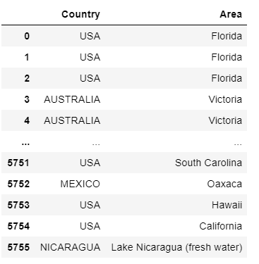
Data manipulation
Creating dataframes for :
Shark attacks per year
Areas within all countries
Areas within the 3 countries with the most shark attacks

Slide 6
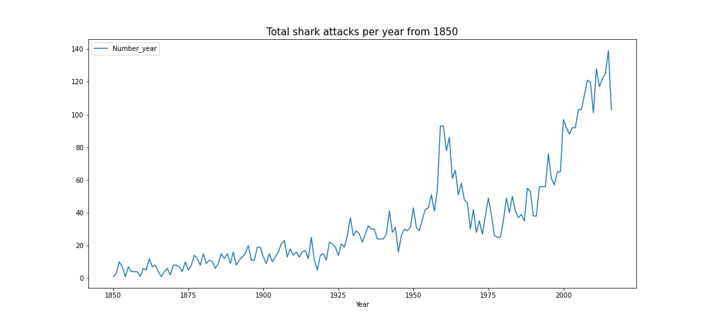
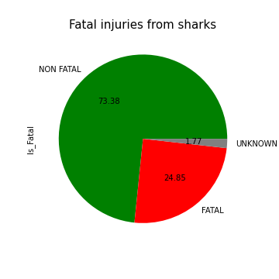
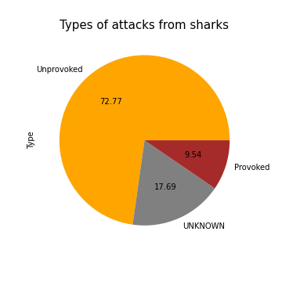
Data vizualisation & Results (1/4)

Slide 7
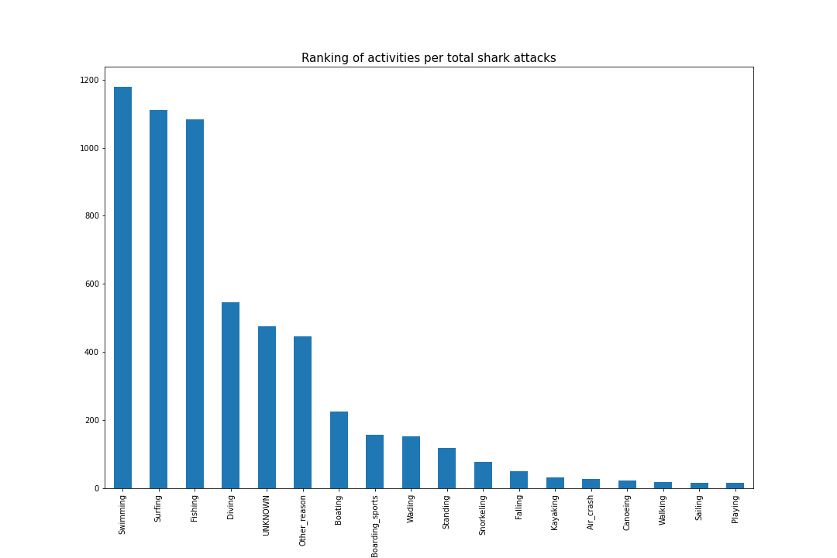
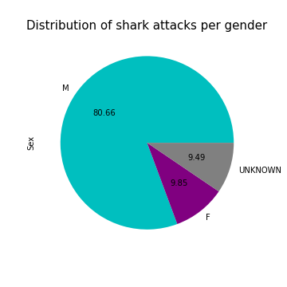
Data vizualisation & Results (2/4)

Slide 8
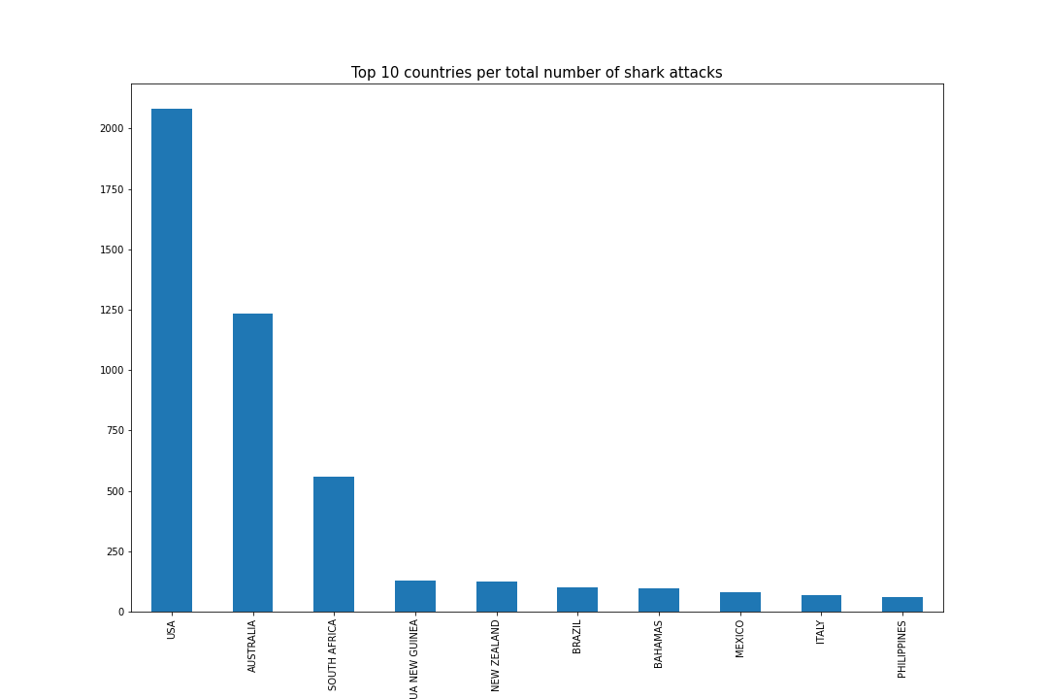
Data vizualisation & Results (3/4)

Slide 9
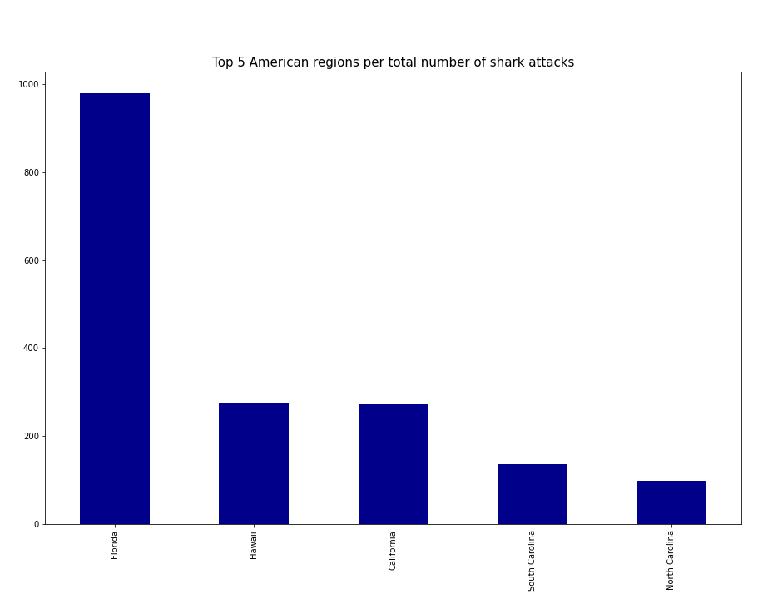
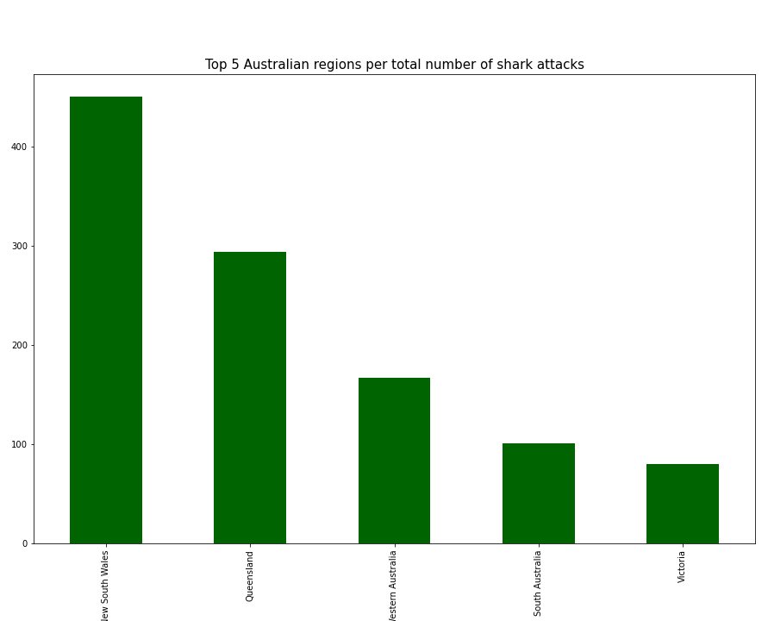
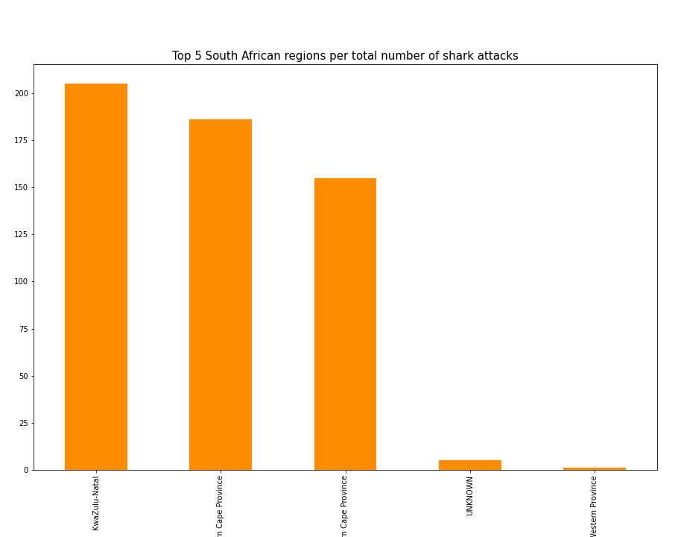
Data vizualisation & Results (4/4)

Slide 10


Obstacles and Lessons
Obstacles
Understanding the data within the file
Choosing the right columns/data to work with to answer the problem
Simplifying some code from Jupyter to Spyder
Lessons
Learning how to clean new data
Using plots (defining type of plot, color, title)

